Slide 1
Electric Air Guitar
William Ojemann
BIOEN 468

Slide 2

Motivation and Statement of Purpose

Slide 3
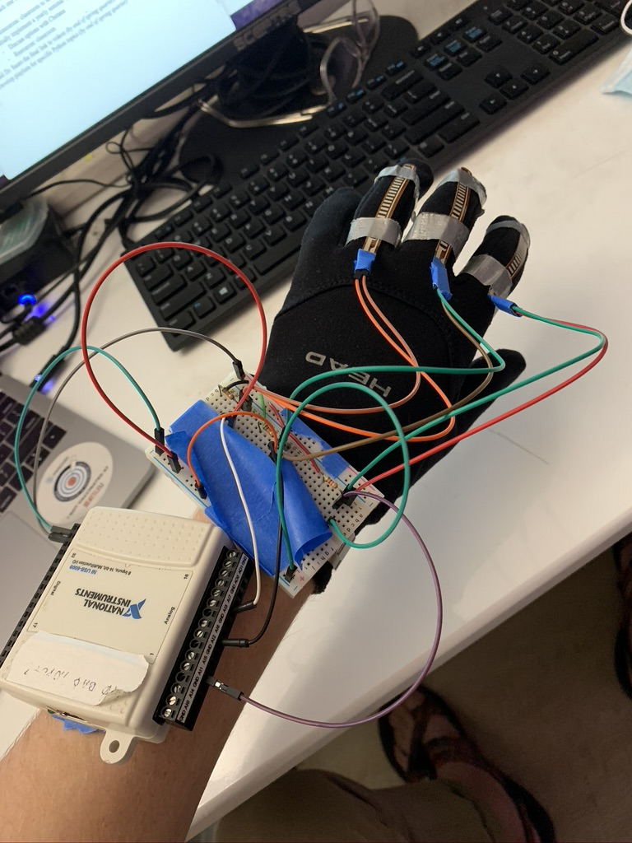
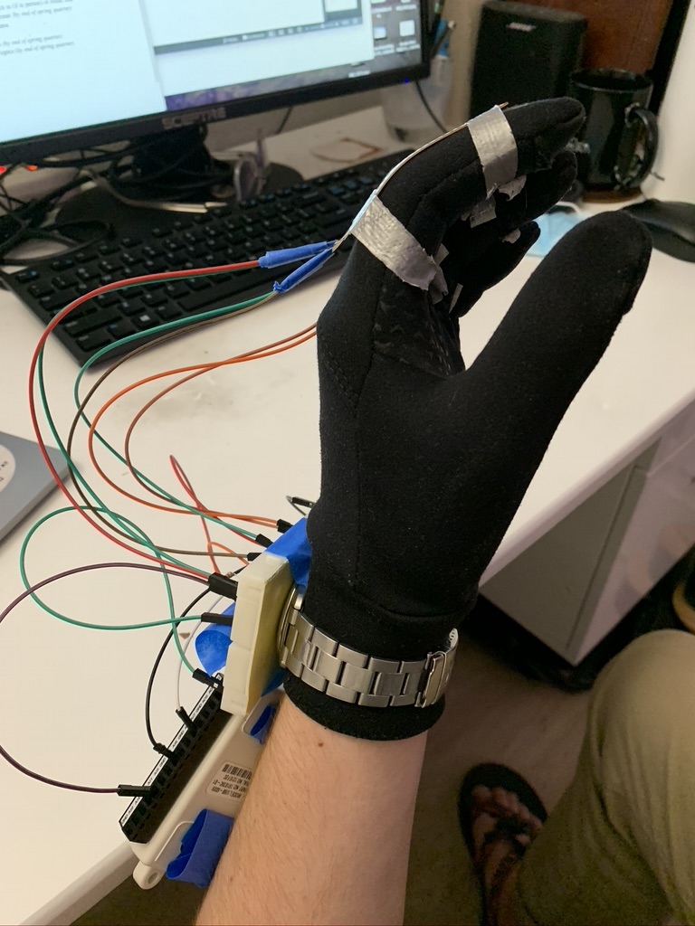
What is an electric air guitar?

Slide 4

How do you go from electrons to sweet melodies?
1
2
3
4
5
6
7

Slide 5
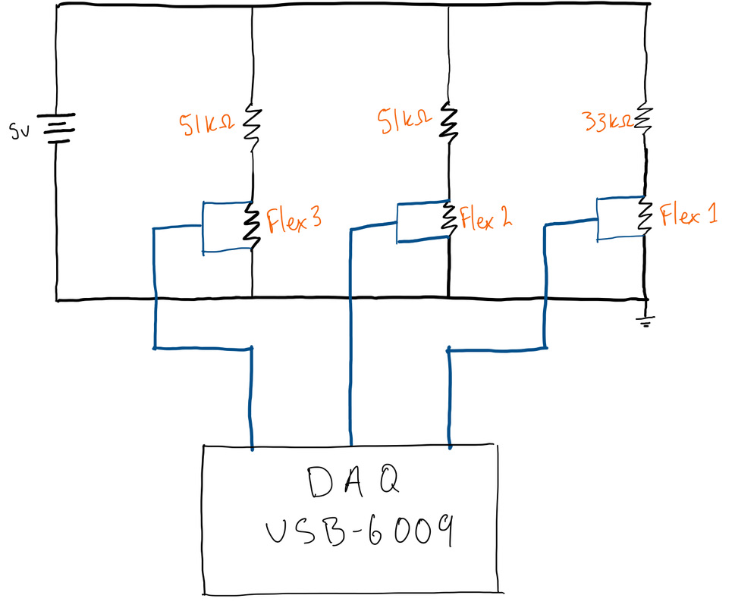
How do the circuits work?

Slide 6
And the software?

Slide 7
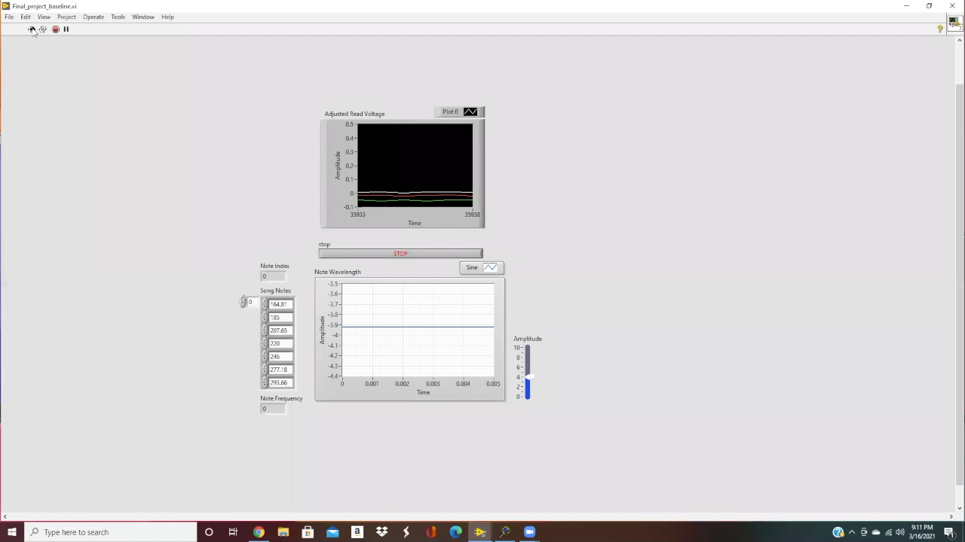
Well … can you play it?

Slide 8
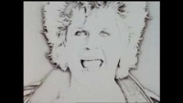
In case you are unfamiliar…

Slide 9
There is some room for improvement!
Adding another flex sensor for 4 bit note encoding
Play sweet child o’ mine solo
More robust mechanical housing
Consistent resistances
Adding a “pick” triggering system

Slide 10
Thank You!
Questions: wojemann@uw.edu
VIs, Presentation, and Video: https://github.com/wojemann/BIOEN468

Slide 11
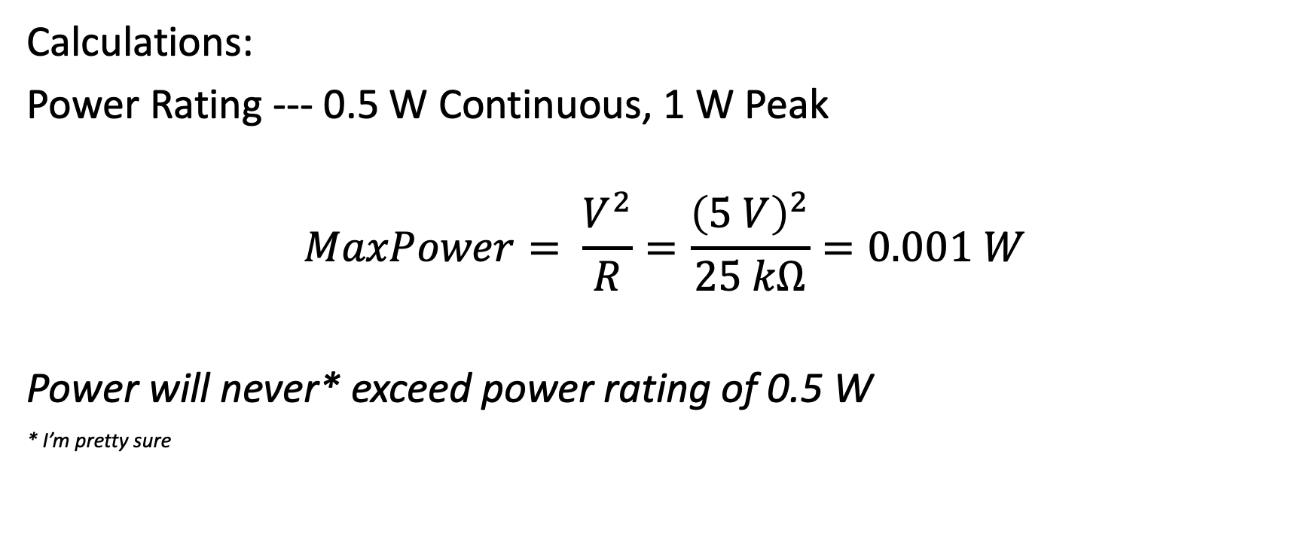
Appendix A
Calculations:
Power Rating --- 0.5 W Continuous, 1 W Peak
$$MaxPower= \frac{V^{2}}{R}=\frac{{\left(5 V\right)}^{2}}{25 kΩ}=0.001 W$$
Power will never* exceed power rating of 0.5 W
* I’m pretty sure

Slide 12
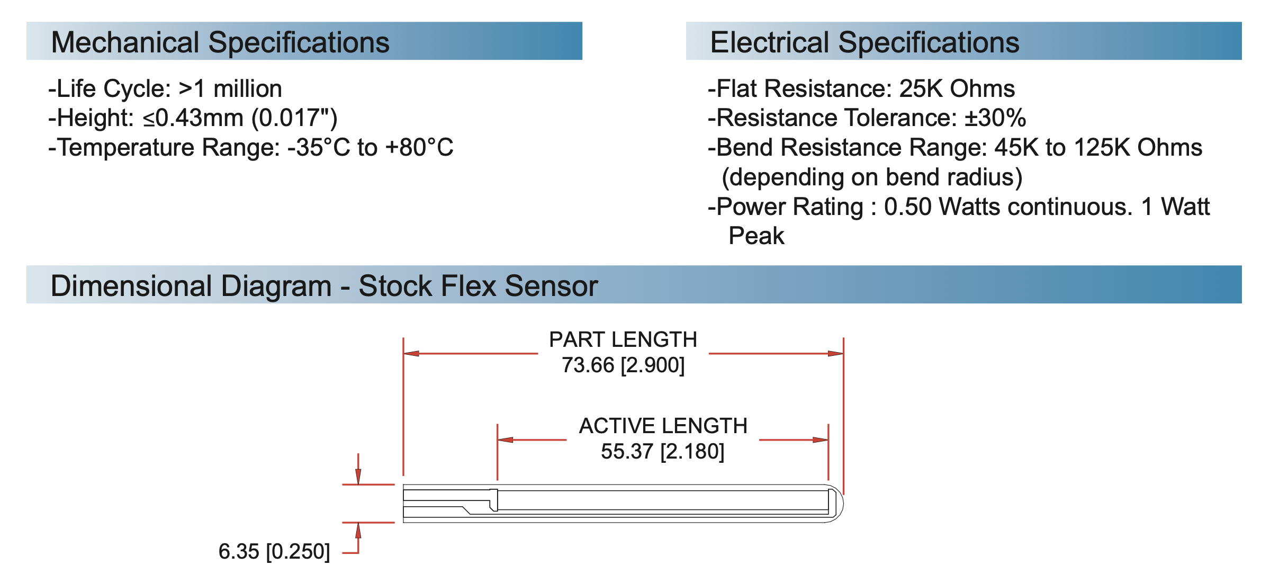
Appendix B

